Slide 1
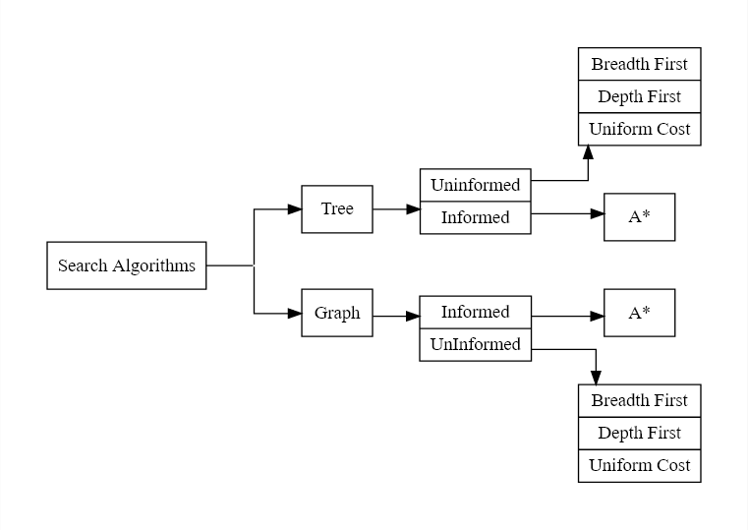

Slide 2
Breadth First Search Tree

Slide 3
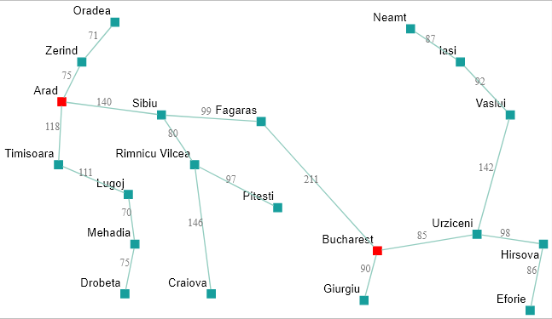
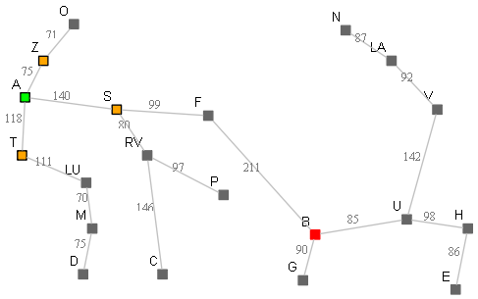
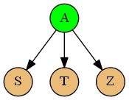

Problem: To find a path from Arad to Bucharest. Not yet cheapest, but just a path. This eg is open ended to start with.
Naive Approach for abstraction: We are in Arad and
below are the only possible next choices.
Note: Above map is open looped to illustrate tree search.
Actual Arad -> Bucharest would contain closed loops, which we will discuss next.
Initialization: OpenSet = { A } cameFrom[A] = null
1. Check:
Is OpenSet is empty.? { A } No
current = remove one node from OpenSet (selection strategy) = { A }
OpenSet = {}
Is current == goal? No.
Add neighbors of current node to OpenSet.
OpenSet = {} + { S, T, Z } = { S, T, Z }
cameFrom[S,T,Z] = A

Slide 4
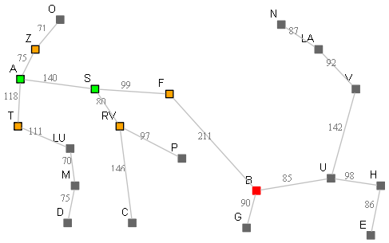
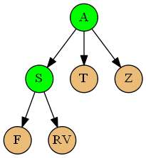

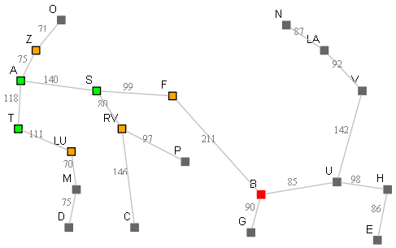
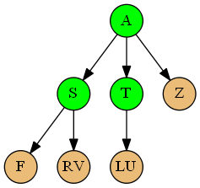

2. Check:
Is OpenSet is empty.? { S, T, Z } No
current = remove one node from OpenSet (selection strategy) = { S }
OpenSet = {T, Z}
Is current == goal? No.
Add neighbors of current node to OpenSet.
OpenSet = {T, Z} + { F, RV } = { T, Z, F, RV }
cameFrom[F,RV] = S
3. Check:
Is OpenSet is empty.? {T , Z, F, RV } No
current = remove one node from OpenSet (selection strategy) = { T }
OpenSet = {Z, F, RV }
Is current == goal? No.
Add neighbors of current node to OpenSet.
OpenSet = { Z, F, RV } + { LU } = { Z, F, RV, LU }
cameFrom[LU] = T

Slide 5
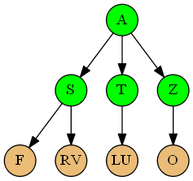
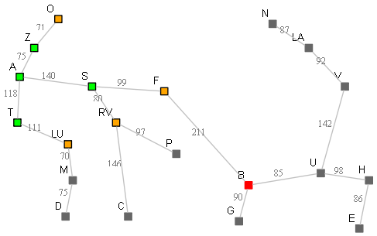

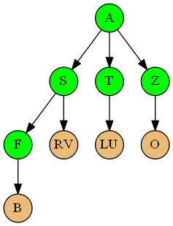
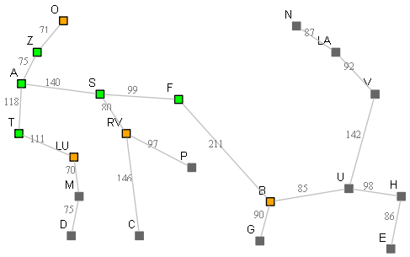

4. Check:
Is OpenSet is empty.? = { Z, F, RV, LU } No
current = remove one node from OpenSet (selection strategy) = { Z }
OpenSet = { F, RV, LU }
Is current == goal? No.
Add neighbors of current node to OpenSet.
OpenSet = {F, RV, LU } + { O } = { F, RV, LU, O }
cameFrom[O] = Z
5. Check:
Is OpenSet is empty.? = { F, RV, LU, O } No
current = remove one node from OpenSet (selection strategy) = { F }
OpenSet = { RV, LU, O }
Is current == goal? No.
Add neighbors of current node to OpenSet.
OpenSet = { RV, LU, O } + { B } = { RV, LU, O, B }
cameFrom[B] = F

Slide 6
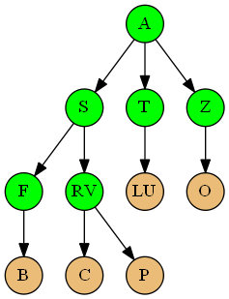
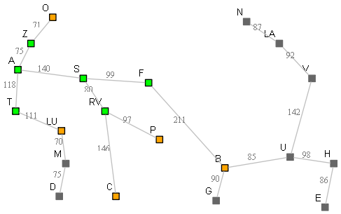

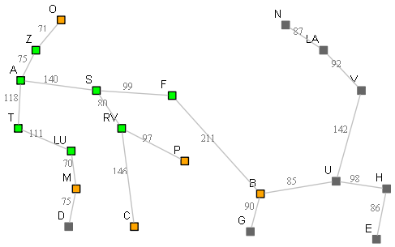
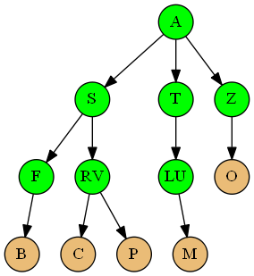

6. Check:
Is OpenSet is empty.? = { RV, LU, O, B } No
current = remove one node from OpenSet (selection strategy) = { RV }
OpenSet = { LU, O, B }
Is current == goal? No.
Add neighbors of current node to OpenSet.
OpenSet = { LU, O, B } + { C, P } = { LU, O, B, C, P }
cameFrom[C,P] = RV
7. Check:
Is OpenSet is empty.? = { LU, O, B, C, P } No
current = remove one node from OpenSet (selection strategy) = { LU }
OpenSet = { O, B, C, P }
Is current == goal? No.
Add neighbors of current node to OpenSet.
OpenSet = {O, B, C, P } + { M} = { O, B, C, P, M }
cameFrom[M] = LU

Slide 7
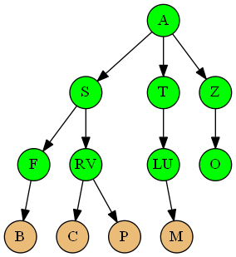


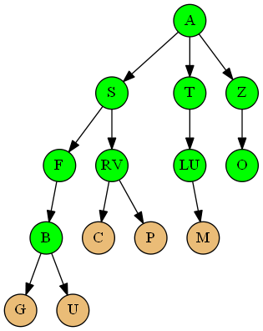
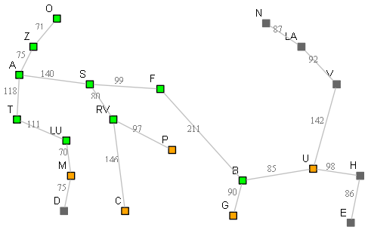

8. Check:
Is OpenSet is empty.? = { O, B, C, P, M } No
current = remove one node from OpenSet (selection strategy) = { O }
OpenSet = { B, C, P, M }
Is current == goal? No.
Add neighbors of current node to OpenSet.
OpenSet = {B, C, P, M} + { } = { B, C, P, M }
cameFrom[] = ‘’”
9. Check:
Is OpenSet is empty.? = { B, C, P, M } No
current = remove one node from OpenSet = { B }
OpenSet = { C, P, M }
Is current == goal? YES. return reversed (reconstruct_path(B))

Slide 8
Pseudocode: Main Strategy
def BFS:
OpenSet = { start }
cameFrom[start] = null
While OpenSet is not empty
Step 1. current = remove one node from OpenSet and update OpenSet (selection strategy)
If current == goal? Step 2: Return reconstruct_path(current node)
Step 3: Add neighbors of current node to OpenSet.
Add current node as parent for all those neighbors
Pseudocode: Step 1 ; Remove one node from OpenSet and update OpenSet
Sample Input: OpenSet = { S, T, Z }
Expected Output:
node = S
OpenSet = { T, Z }
Strategy could be anything here. Choose last element, or choose 1st element or choose alphabetically etc.
If we choose, last element, it becomes breadth first search.
List.pop(0) will return the 1st element in list, that is S

Slide 9
Pseudocode: Step 2 reconstruct_path(current node)
cameFrom
Path = [B]
current = cameFrom(B) which is F
Path.append( F )
Current = cameFrom(F) which is S
Path.append( S )
Current = cameFrom(S) which is A
Path.append( A )
Current = cameFrom(A) which is null. STOP. Return Path.
node | parent
A | null
S | A
T | A
Z | A
F | S
RV | S
LU | T
O | Z
B | F
C | RV
P | RV
M | LU
To return: path = { B , F, S, A }
‘node’ : ‘parent’
Key : value
Dictionary in Python
We could later reverse it in post
By below methods..
Path.reverse()
Or
[x for x in reversed(path)]
Path = []
Current = B
Path.append(Current)
While (Current != null):
Current = cameFrom(Current)
Path.append(Current)
Return Path

Slide 10
Pseudocode: Step 3 ;
Add neighbors of current node to OpenSet.
Add current node as parent for all those neighbors
Assumed input form
graph = {
'A': ['S', 'T', 'Z'],
'S': ['F', 'RV'],
'T': ['LU'],
'Z': ['O'],
'F': ['B'],
'B': ['G','U'],
'U':['H','V'],
'V':['LA'],
'LA':['N'],
'RV':['C','P'],
'LU':['M'],
'M':['D'],
'H':['E']
}
For each neighbour of current node
Add it to OpenSet
Add current node as its parent
Key : current_node
Value : list of current_node’s children
For each_children in graph.get(current_node, [])
OpenSet.append(each_children)
cameFrom[each_children] = current_node
This iteratres over list values of each key
If no key exists, returns []

Slide 11
Depth First Search Tree

Slide 12

Problem: To find a path from Arad to Bucharest. Not yet cheapest, but just a path. This eg is open ended to start with.
Naive Approach for abstraction: We are in Arad and
below are the only possible next choices.
Note: Above map is open looped to illustrate tree search.
Actual Arad -> Bucharest would contain closed loops, which we will discuss next.
Initialization: OpenSet = { A } cameFrom[A] = null
1. Check:
Is OpenSet is empty.? { A } No
current = remove one node from OpenSet (selection strategy) = { A }
OpenSet = {}
Is current == goal? No.
Add neighbors of current node to OpenSet.
OpenSet = {} + { S, T, Z } = { S, T, Z }
cameFrom[S,T,Z] = A

Slide 13
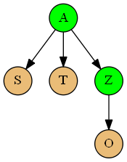
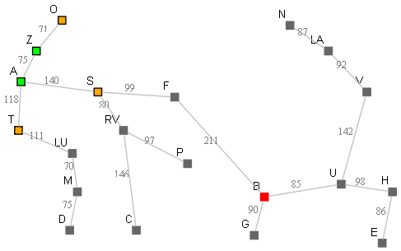

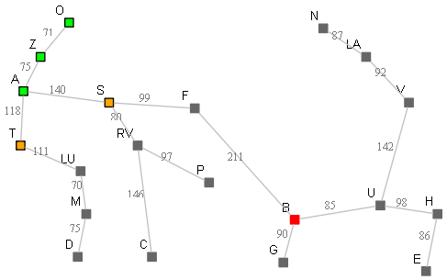
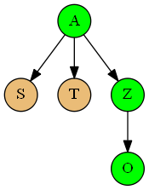

2. Check:
Is OpenSet is empty.? { A } No
LIFO: pop{S,T,Z} = {Z}
Z is not goal
Add Z’s kids. {S,T} + {O} = {S,T,O}
3. Check:
Is OpenSet is empty.? { S,T,O } No
LIFO: pop{S,T,O} = {O}
O is not goal
Add O’s kids. {S,T} + {} = {S,T}

Slide 14
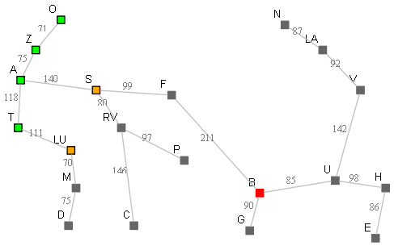
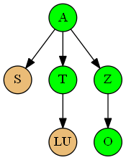

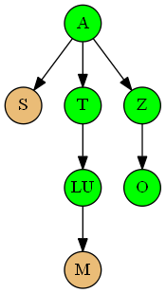
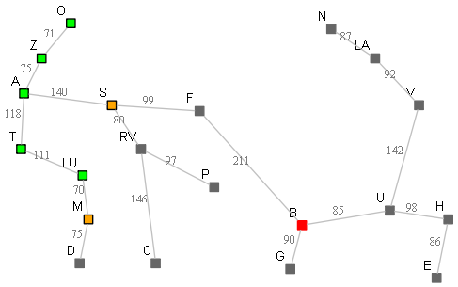

4. Check:
Is OpenSet is empty.? { S,T } No
LIFO: pop{S,T} = {T}
T is not goal
Add T’s kids. {S} + {LU} = {S,LU}
5. Check:
Is OpenSet is empty.? { S,LU } No
LIFO: pop{S,LU} = {LU}
LU is not goal
Add LU’s kids. {S} + {M} = {S,M}

Slide 15
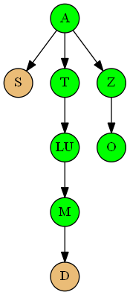
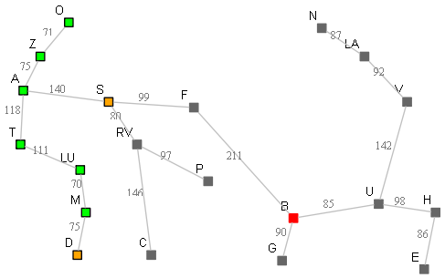

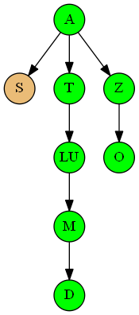
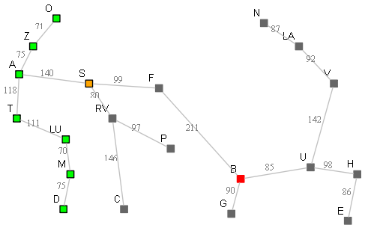

6. Check:
Is OpenSet is empty.? { S,M } No
LIFO: pop{S,M} = {M}
M is not goal
Add M’s kids. {S} + {D} = {S,D}
7. Check:
Is OpenSet is empty.? { S,D } No
LIFO: pop{S,D} = {D}
D is not goal
Add D’s kids. {S} + {} = {S}

Slide 16
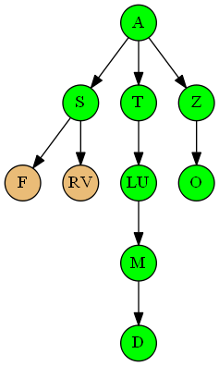
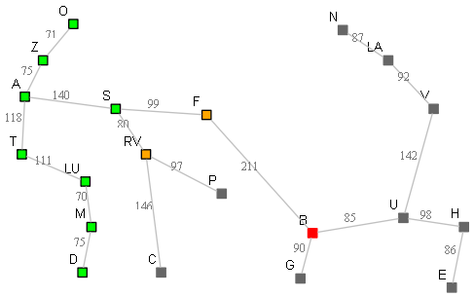

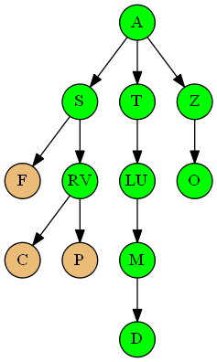
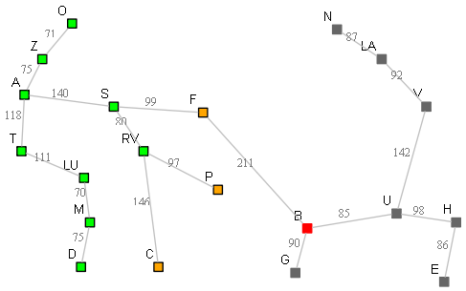

8. Check:
Is OpenSet is empty.? { S } No
LIFO: pop{S} = {S}
S is not goal
Add S’s kids. {} + {F,RV} = {F,RV}
9. Check:
Is OpenSet is empty.? { F,RV } No
LIFO: pop{F,RV} = {RV}
RV is not goal
Add RV’s kids. {F} + {C,P} = {F,C,P}

Slide 17
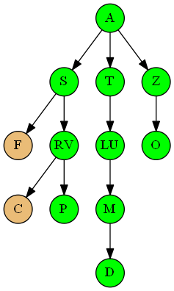
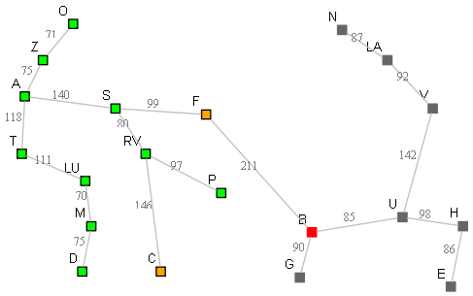

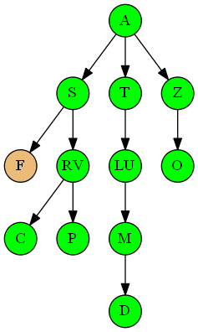


10. Check:
Is OpenSet is empty.? { F,C,P } No
LIFO: pop{F,C,P} = {P}
P is not goal
Add P’s kids. {F,C} + {} = {F,C}
11. Check:
Is OpenSet is empty.? { F,C } No
LIFO: pop{F,C} = {C}
C is not goal
Add C’s kids. {F} + {} = {F}

Slide 18
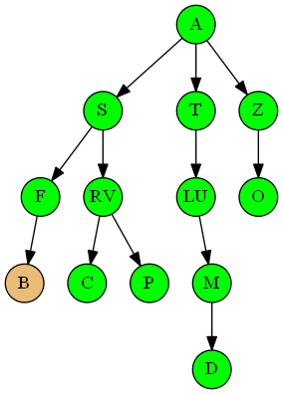
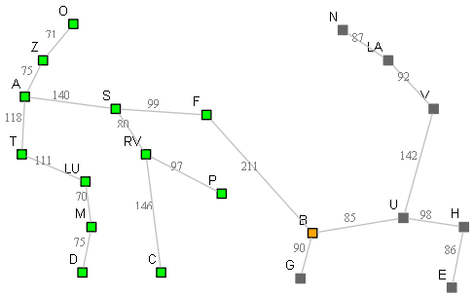

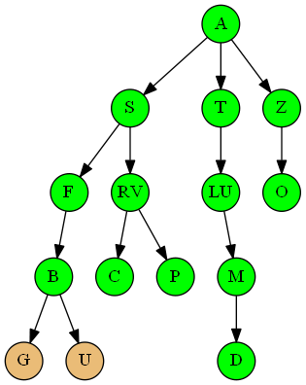
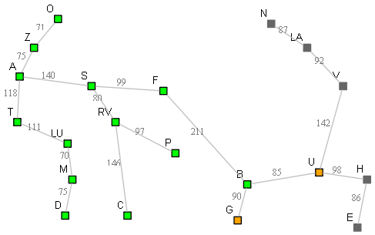

12. Check:
Is OpenSet is empty.? { F } No
LIFO: pop{F} = {F}
F is not goal
Add F’s kids. {} + {B} = {B}
13. Check:
Is OpenSet is empty.? { B } No
LIFO: pop{B} = {B}
B is goal. Return reversed(path)

Slide 19
Pseudocode:
def DFS:
OpenSet = { start }
cameFrom[start] = null
While OpenSet is not empty
Step 1. current = remove one node from OpenSet and update OpenSet (selection strategy)
If current == goal? Step 2: Return reconstruct_path(current node)
Step 3: Add neighbors of current node to OpenSet.
Add current node as parent for all those neighbors
Programmatically only one change required in BFS to make it DFS. In Step 1 above, instead of OpenSet.pop(0), pop the last element, that is OpenSet.pop()

Slide 20
Useful links:
http://dai.fmph.uniba.sk/courses/intro-ai/reading/3ed-ch03-search.pdf
https://stackoverflow.com/questions/10680180/graph-search-vs-tree-search
https://stackoverflow.com/questions/8922060/how-to-trace-the-path-in-a-breadth-first-search
https://www.redblobgames.com/pathfinding/a-star/implementation.html
https://www.geeksforgeeks.org/using-list-stack-queues-python/
Dot snippets for graphs: https://www.codepile.net/pile/0oJMNaBp
Bfs_tree_1 code: https://www.codepile.net/pile/3PZn5kPQ
docHelpers.py: https://www.codepile.net/pile/Nd3qvbmX

